Slide 1
Malthusian Theory of Population

Slide 2
Introduction
The Malthusian theory explained that the population grows in a geometrical fashion. However, the food supply grows in an arithmetic progression.
As a result, people will not get enough food even for survival. People will die due to a lack of food supply.

Slide 3
Assumption
Food is necessary for life.
Food production increases arithmetically (1,2,3,4,5 etc.)
Population, on the other hand, increases geometrically or exponentially (1,2,4,8,16, etc.).
Passion between men and women is necessary and will continue unchanged.
Population is limited by food—population increases when food increases, unless prevented by some checks

Slide 4
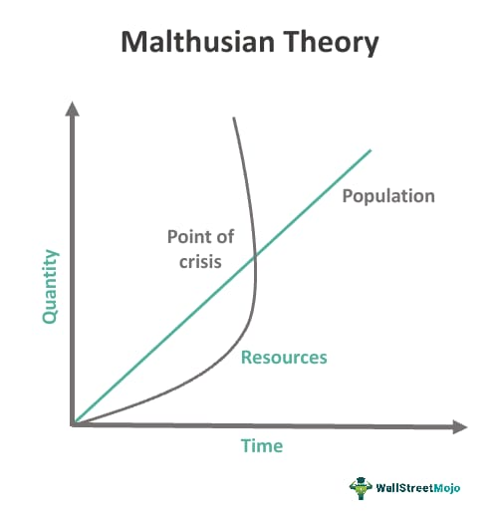
Diagram

Slide 5
Malthus referred to two classes of checks which kept population down:
1. Positive means:
He spoke of famine (hunger), disease or war, pestilence and vicious customs about women.
2. Negative means\preventive’ checks:
He explicitly demanded artificial means of birth control and suggested as an alternative that birth rate be decreased through preventive measures such as late marriage (postponing marriage until later age), moral restraint, and chastity (abstinence).

